Slide 1
Real-time Static Gesture Detection Using Machine Learning
From: Sandipgiri Goswami
Supervisor : Dr.Kalpdurm Passi

Slide 2
Contents
About American Sign Language (ASL)
Objectives
Dataset
Hardware & Software used
Image Processing
Machine Learning approach
Results
Future work

Slide 3
About Language:
The method of human communication, either spoken or written, consisting of use of words in structured and conventional way.
There are roughly 6,500 spoken languages in the world today.
English as a global language.
With more than 350 million people around the world speaking English as a first language and more than 430 million speaking it as a second language.

Slide 4
About Sign Language
Convey a message by hand movements, facial expression and body language to communicate.
It is mainly used by deaf and dumb but with hearing capability.
Sometimes family members and relatives must learn sign language to interpret for the dumb and for the wider communities to communicate with each other.
In fact, there are somewhere between 138 and 300 different types of sign languages used throughout the world today

Slide 5
Different Sign Languages in the Americas
North America | Central America | South America
•American Sign Language •Inuit Sign Language •Quebec Sign Language •Puerto Rican Sign Language | •Costa Rican Sign Language •Guatemalan Sign Language •Honduras Sign Language •Mayan Sign Language •Mexican Sign Language •Nicaraguan Sign Language •Panamanian Sign Language •Salvadorian Sign Language •Tijuana Sign Language | •Argentine Sign Language •Bolivian Sign Language •Brazilian Sign Language •Chilean Sign Language •Colombian Sign Language •Ecaudorian Sign Language •Paraguayan Sign Language •Peruvian Sign Language •Uruaguayan Sign Language •Venezuelan Sign Language

Slide 6
Misunderstandings about Sign Language
Similar to spoken language.
Unique language all over the world.
Easy to learn.
Easy to communicate.

Slide 7
About American Sign Language(ASL)
Implemented from French sign language.
Introduced by Thomas Hopins in the United States.
ASL is similar to French sign language.
A variation of American Sign Language also exits.

Slide 8
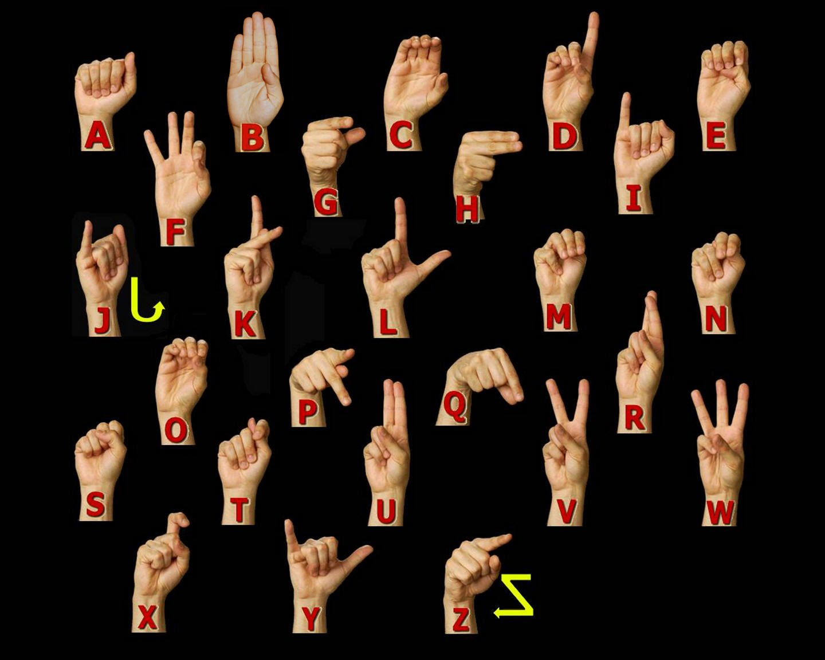
ASL Manual Alphabet

Slide 9
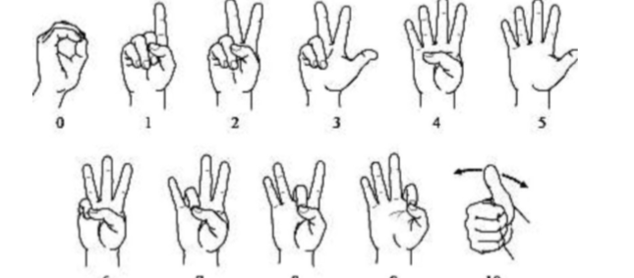
American Sign language numbers

Slide 10
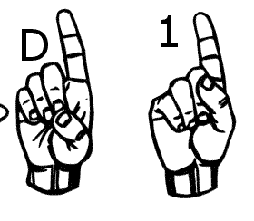
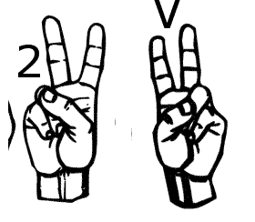
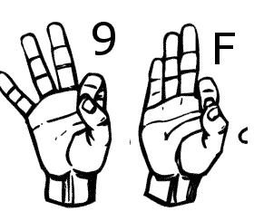
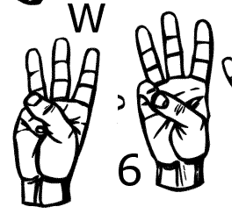
Similar Sign Gesture

Slide 11
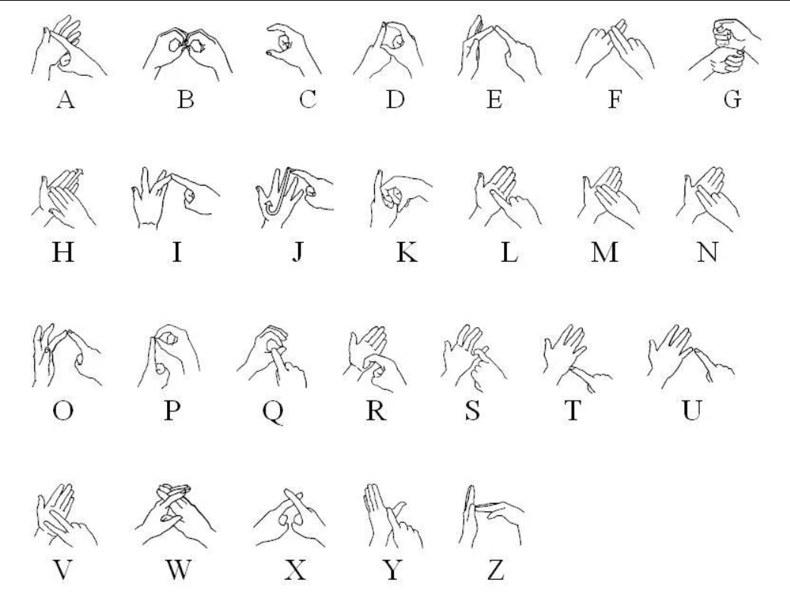
British Sign Language

Slide 12
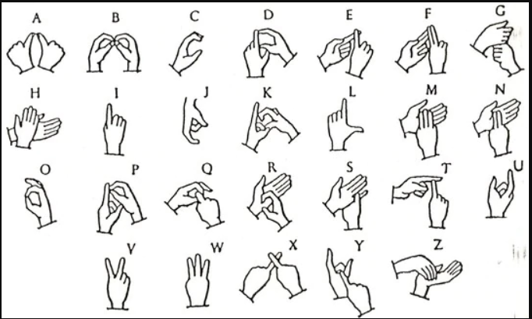
India Sign Language

Slide 13
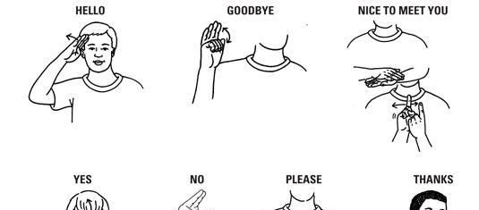
A few words in Sign language

Slide 14
Statistics of sign language use in Canada
American Sign Language | 2,485
Quebec Sign Language | 730

Slide 15
Statistics of Knowledge of Sign Languages
American Sign Language | 11,110
Quebec Sign Language | 730

Slide 16
Objectives:
Help the deaf community to increases their self-esteem and IQ level.
Deaf individual can learn by themselves
Easy learning tool

Slide 17
Dataset Description and Image property
Property | Description
Alphabets | A to Z
Numbers | 0 to 9
Color | Gray Scale
Dimensions | 50x50
Height | 50 pixels
Width | 50 pixels

Slide 18






Dataset Sample
S | A | N | D | I | P

Slide 19
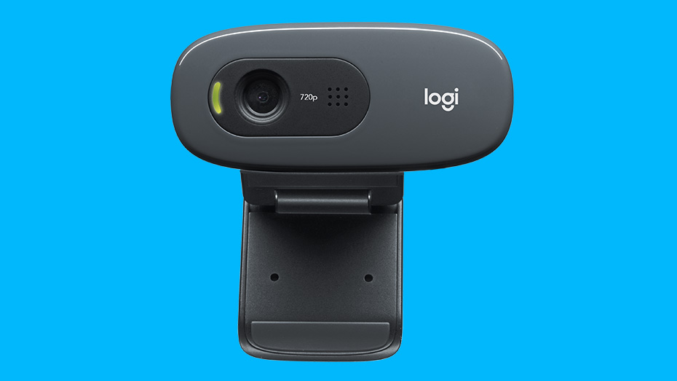
Hardware Configurations
GPU | GeForce GTX 1080 4GB
CPU | Intel(R) Core(TM) i7-8550 CPU @ 2.00GHz
Memory | DIMM 1333MHz 8GB

Slide 20
Software
Keras | 2.04
Tensor flow | 1.1.0
Python | 3.53
Operating System | Window 10
Open CV | 2.0

Slide 21

Software Used
Python
Tensor flow
Keras
OpenCV (Open Source Computer Vision Library)

Slide 22
Different software libraries
NumPy
Matplotlib
Pickle

Slide 23
Image Processing
Image capture
Pre-processing
Segmentation detection
Description
Classification
Notes:
A Gaussian filter is a linear filter. It's usually used to blur the image or to reduce noise. ... The Gaussian filter alone will blur edges and reduce contrast. In blurring, we simply blur an image. An image looks more sharp or more detailed if we are able to perceive all the objects and their shapes correctly in it. ... This shape of an object is due to its edges.

Slide 24
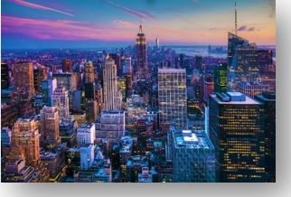
Color Image

Slide 25
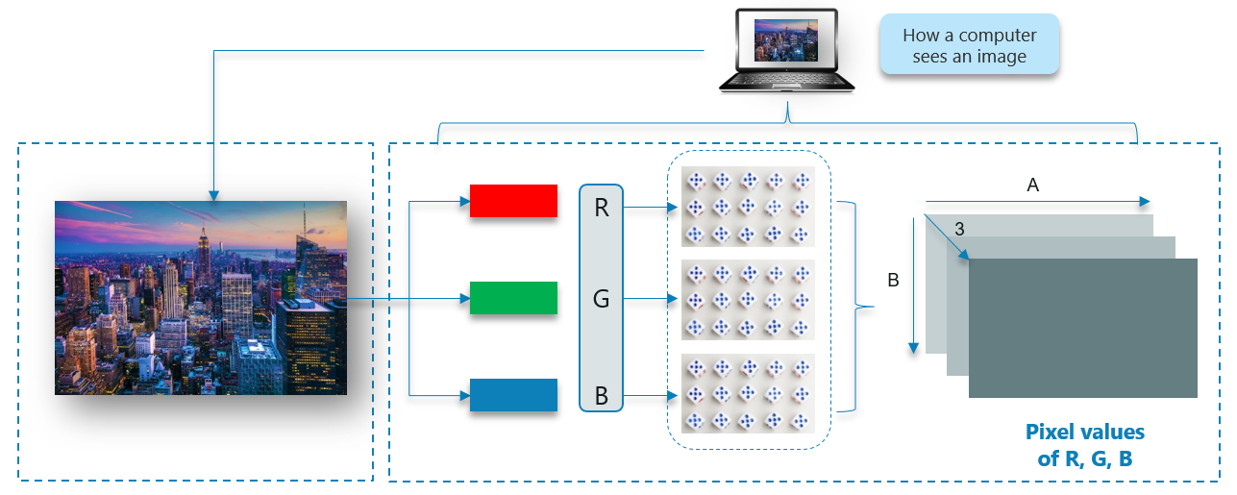
How Does A Computer Read an Image?

Slide 26
Gray Scale image

Slide 27
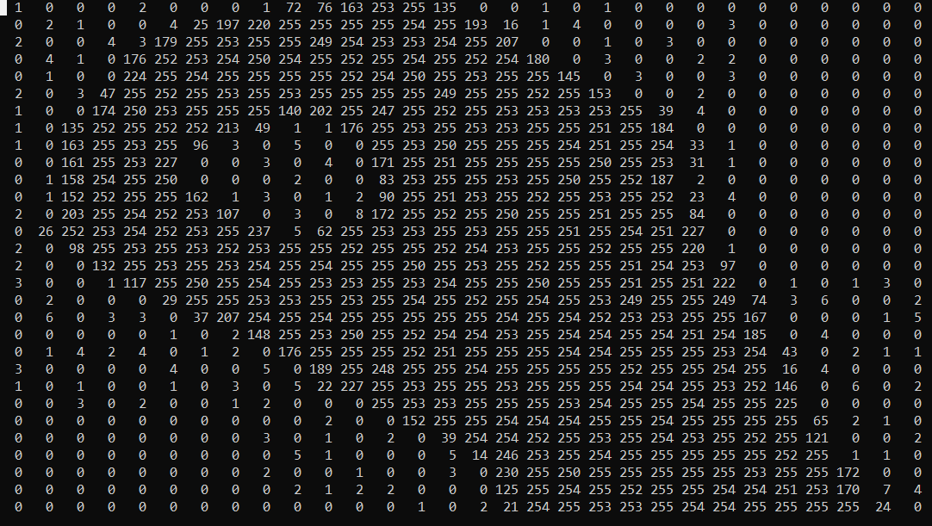
Gray scale image to 2D matrix

Slide 28
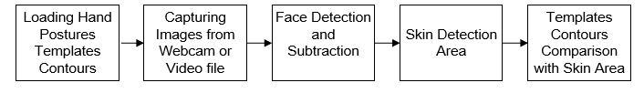
Hand posture detection steps

Slide 29
My Approach for Hand Detection
Skin Detection
Contour Comparisons

Slide 30
Machine Learning Approach
Unsupervised Learning
Supervised Learning

Slide 31
Unsupervised Learning
The model is trained by detecting new data and recognising patterns in the data without being instructed on what they are.
The model can learn from data without supervision.
This means that there is no need for input data to be labeled.
Requires less time and resources to deploy.
The mainstream of unsupervised learning procedures are based on clustering algorithms.

Slide 32
Unsupervised Learning Models
K-means -clustering model
Self Organizing Maps (SOMs)
Principal Component Analysis (PCA) - dimensionality reduction

Slide 33
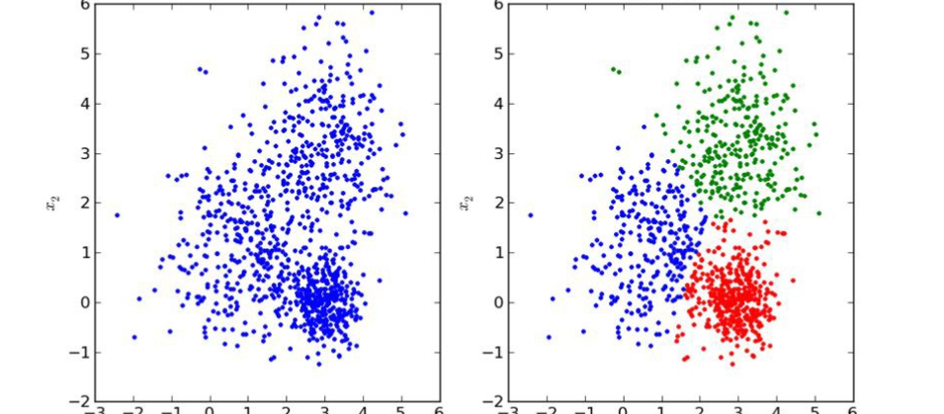
Unsupervised Learning Image

Slide 34
Supervised Learning
The supervised learning method is more commonly used.
This method needs training data with a specific format. Each instance must have assigned label.
Supervised learning problems can be further grouped into regression and classification problems.
The training process of supervised learning is as follows

Slide 35
Structure of Machine Learning Algorithms
Dataset description
Model
Cost function
Optimization technique

Slide 36

Supervised Learning Models
Some popular examples of supervised machine learning algorithms are:
Linear regression for regression problems.
Random forest for classification and regression problems.
Support vector machines for classification problems.

Slide 37

Dataset Description and Model
Dataset: Supervised learning requires data sets with detailed properties. Each dataset holds a set of 𝑛 instances which contain a pair of input vector $x_{i}$ and output scalar $y_{i}$. Input vector Where 𝑖 is an index of an instance, 𝑝, is a length of the input vector.
$x_{i}^{T}=\left[x_{1},x_{2},…,x_{p}\right],$
Model : For each model has parameters represented by vector 𝜃, which are used during the training process. The modest example of the model type is a linear model, also called linear regression. Parameters 𝜃 of this model are
$θ^{T}=\left[θ_{1},θ_{2},…,θ_{p}\right]$,
Where 𝑝 is the number of parameters equal to the size of input vector $x_{i}$. Prediction ${\hat{y}}_{i}$ of the model on instance 𝑖 is computed as
${\hat{y}}_{i}$=$\sum_{j=1}^{p}{x_{ij}}θ_{j}$

Slide 38
Neural Network Architecture
Single layer feed forward network.
Multilayer Feed Forward Network

Slide 39
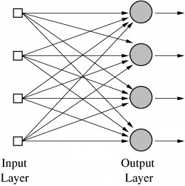
Single Layer feed forward network

Slide 40
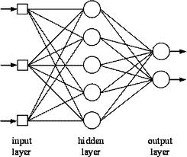
Multilayer feed forward network

Slide 41
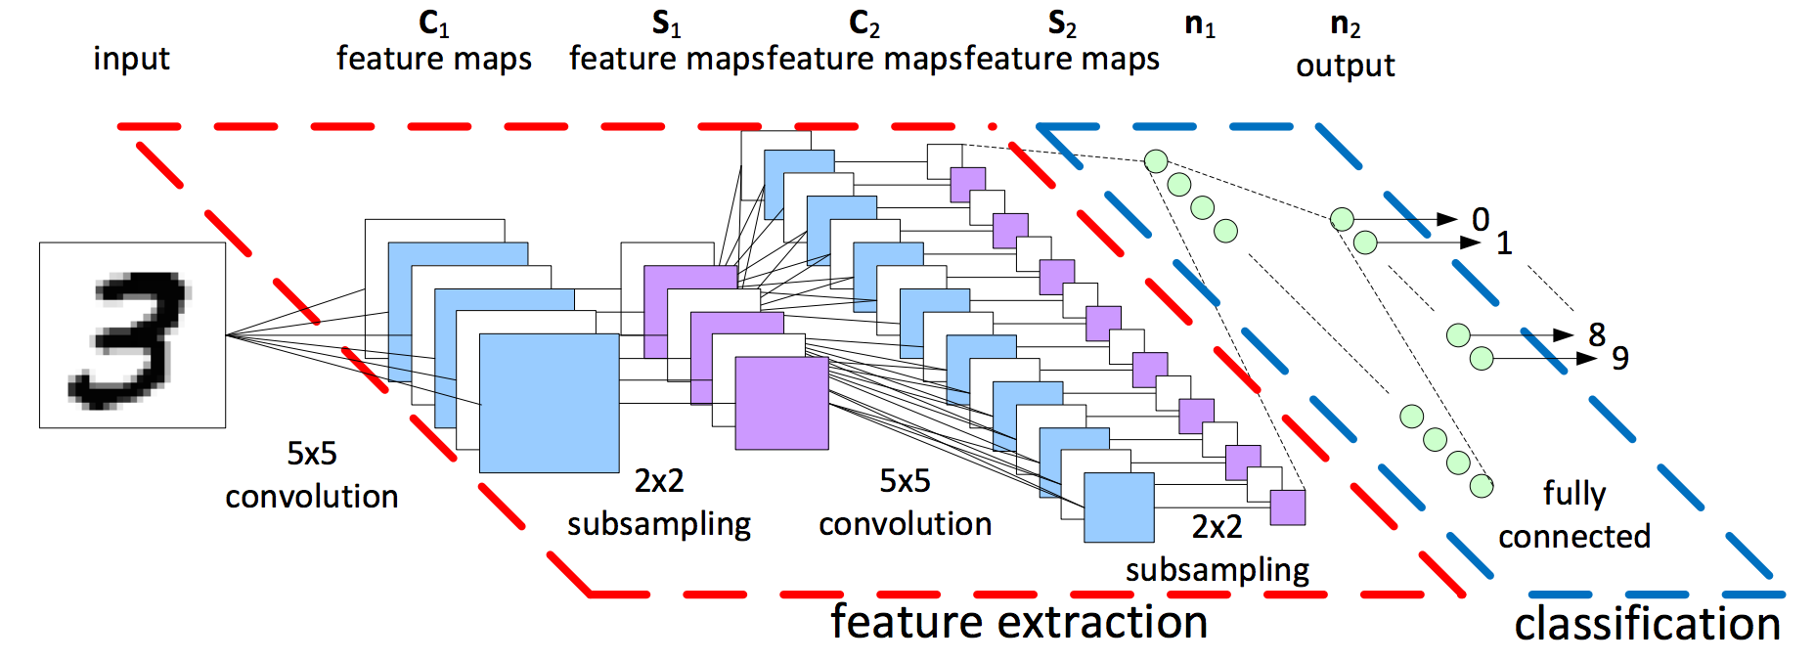
Convolutional Neural Network (CNN) Architecture

Slide 42
Model Structure
Inputs
Weights
Bias
Pooling Layer
Activation Function
Fully Connected Layer
Dropout
Flatten

Slide 43
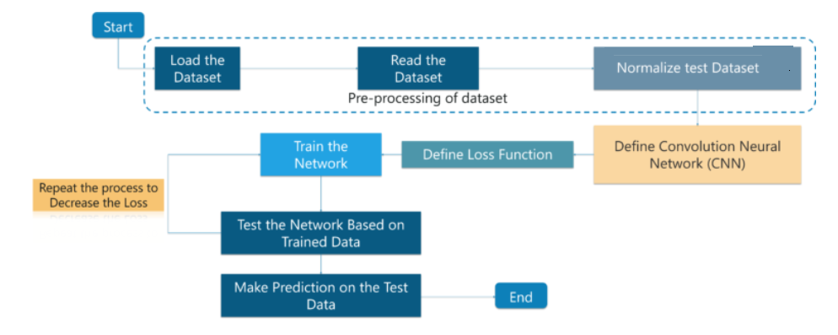
Flowchart

Slide 44
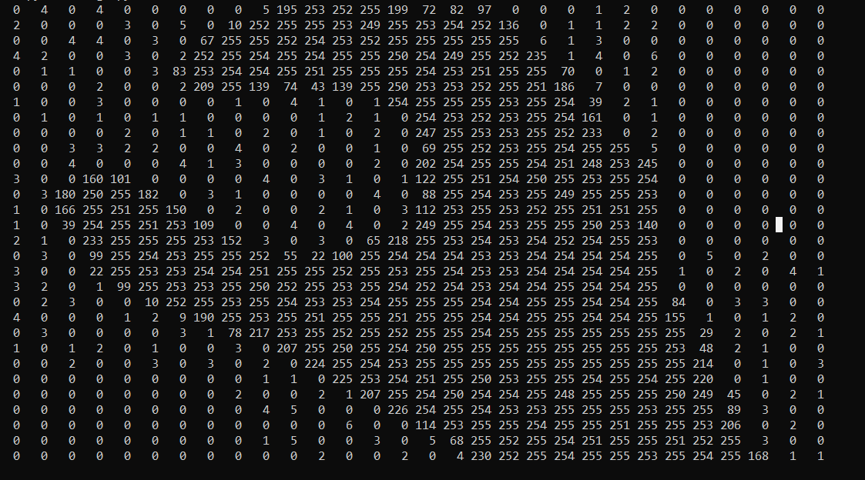
Input image to 2D matrix

Slide 45
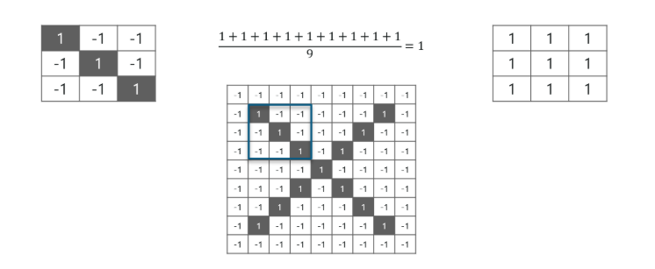
Apply Filter to input image

Slide 46
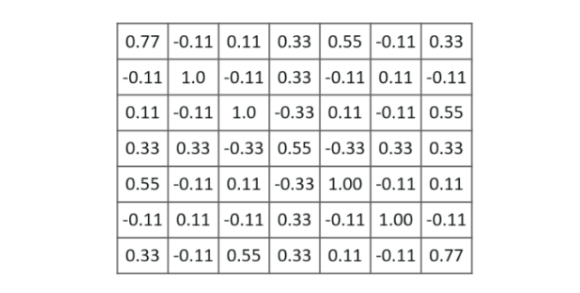
Image after application of filter

Slide 47
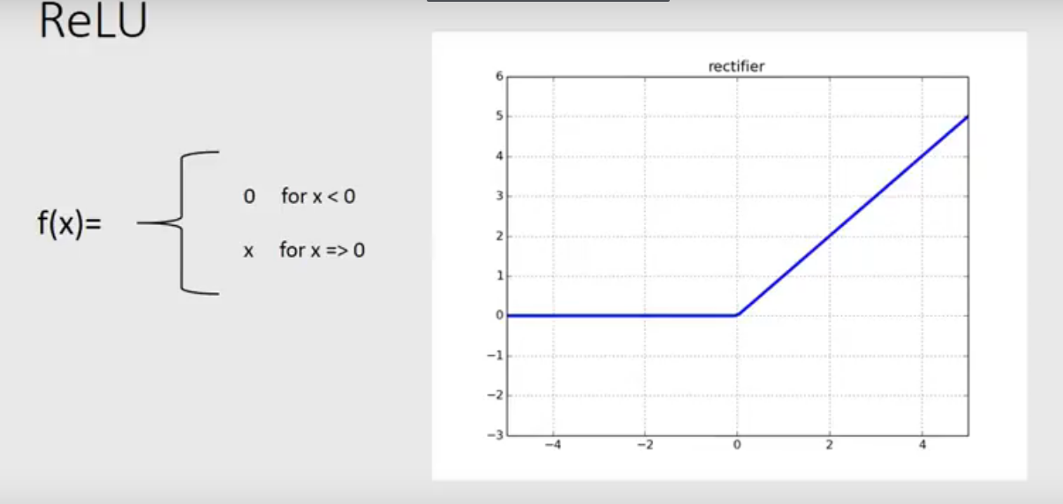
Activation Function

Slide 48
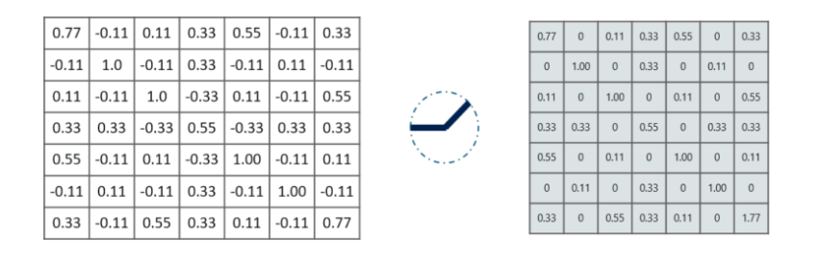
Apply RELU activation Function

Slide 49
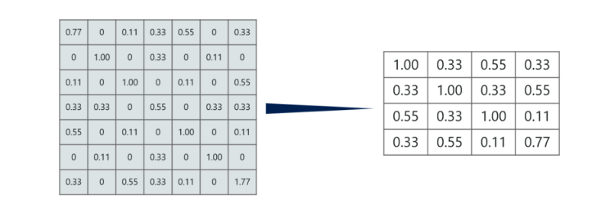
Max pooling layer

Slide 50
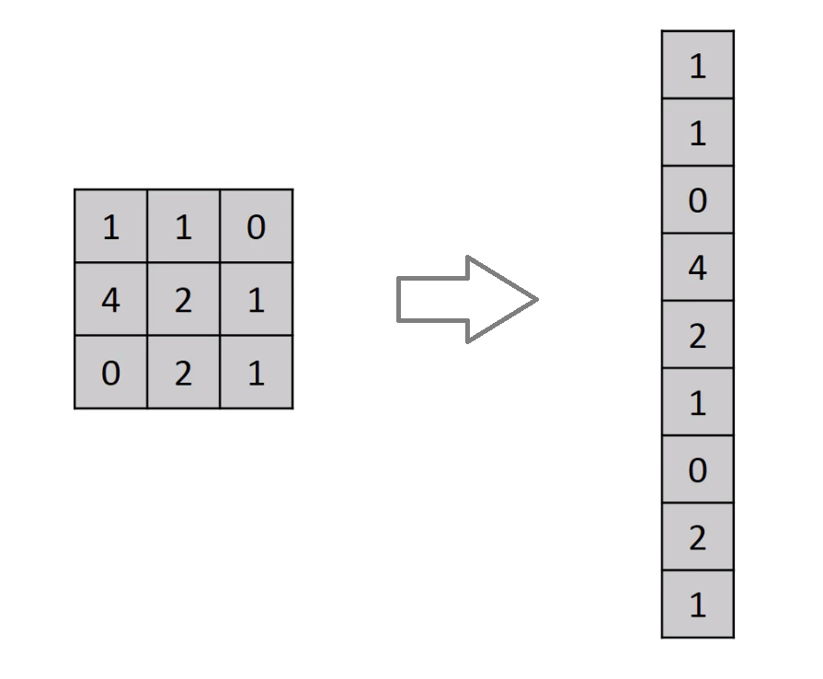
Flatten Layer

Slide 51
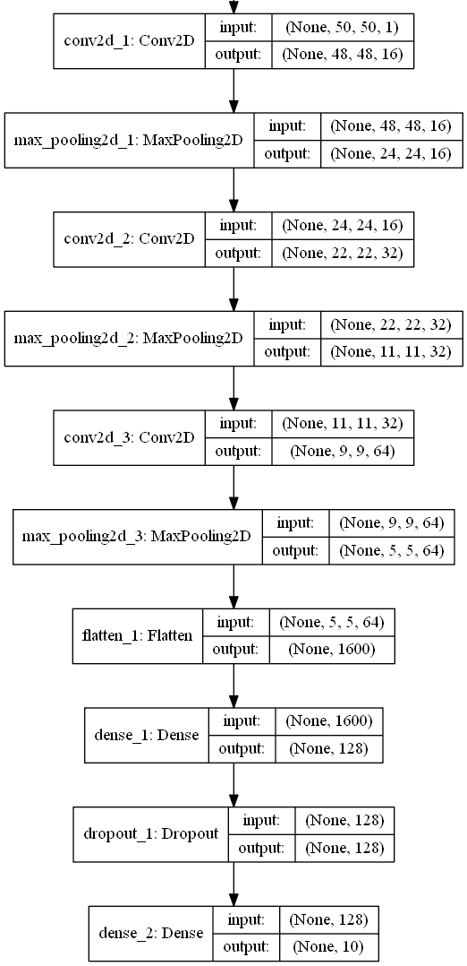
CNN Architecture

Slide 52
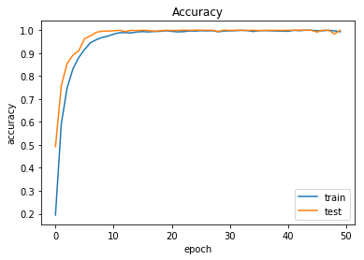
Training and Test Results on Alphabets

Slide 53
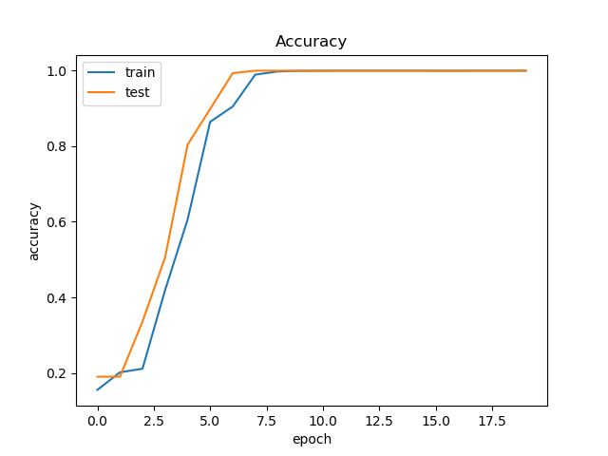
Training and Test Results for Digits

Slide 54

Confusion matrix
Recall =$\frac{true positives}{true positives+false negatives}$
Precision =$\frac{true positives}{true positives+false positives}$

Slide 55
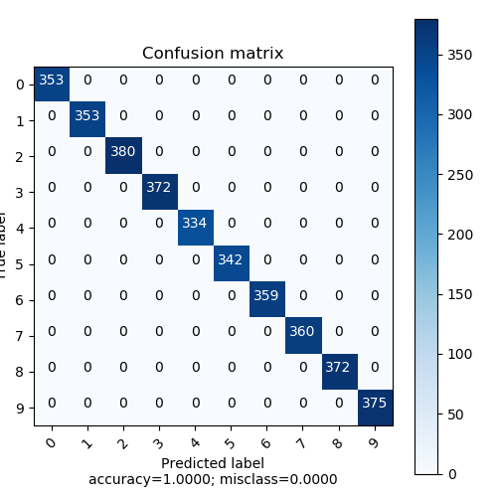
Confusion matrix for 0 to 9 digits

Slide 56
 | precision | recall | f1-score | support
0 | 1.00 | 1.00 | 1.00 | 353
1 | 1.00 | 1.00 | 1.00 | 353
2 | 1.00 | 1.00 | 1.00 | 380
3 | 1.00 | 1.00 | 1.00 | 372
4 | 1.00 | 1.00 | 1.00 | 334
5 | 1.00 | 1.00 | 1.00 | 342
6 | 1.00 | 1.00 | 1.00 | 359
7 | 1.00 | 1.00 | 1.00 | 360
8 | 1.00 | 1.00 | 1.00 | 372
9 | 1.00 | 1.00 | 1.00 | 375
micro avg | 1.00 | 1.00 | 1.00 | 3600
macro avg | 1.00 | 1.00 | 1.00 | 3600
weighted avg | 1.00 | 1.00 | 1.00 | 3600

Slide 57
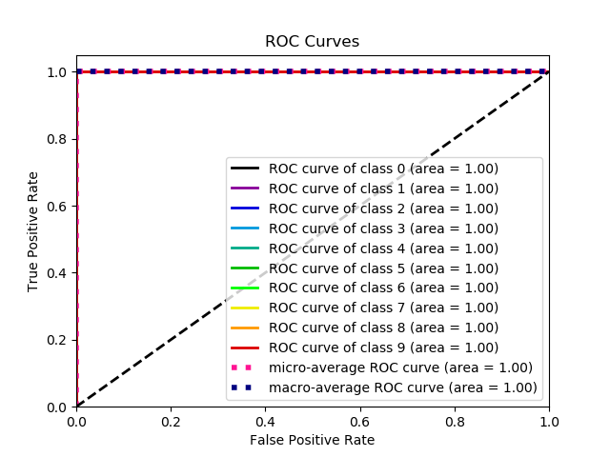

Slide 58
Future work
Dynamic Sign Gesture Recognition
Sign Gesture Recognition from a video
Apply to 3 Dimension technique
Add more gestures in the dataset

Slide 59
Thank you

